Slide 1

Two Sigma: Using News to Predict Stock Movement
Team Member: Archer Mo, Bruce Sharpe, Kishi Zhou

Slide 2

Project Overview
Goal
Data Set
Process
Platform
Use the content of news analytics to predict stock price performance
News Data:
9 millions*32
Market Data:
4 millions *16
Data exploration 20% - Data Cleaning 60% - Model Building 20%
Maximum memory allowance: 17 GB & CPU Cores: 4

Slide 3

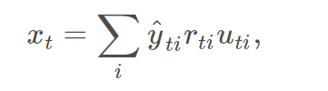


Evaluation
Predict a signed confidence value [-1, 1]
Training set timeline: 2007 – 2018
Validation set timeline 2019. January – 2019. July
Market Return
whether a particular asset is included in scoring
Confidence value

Slide 4
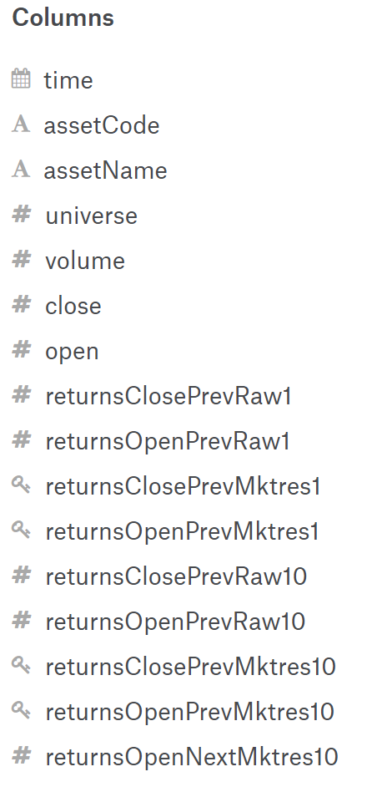
Market Data
Time: from 2007 to present
Asset Code & Asset Name : primary keys to connect news dataset
Open: open price for the day
Returns: Open – close
Prev – Next
Raw – Mktres
1 -10

Slide 5
Example of Market Data
https://www.kaggle.com/c/two-sigma-financial-news/data

Slide 6
Market Data Cleaning
Remove data before 2010
- Stock prices experienced significant changes during the financial crisis
Fill in Missing open/ close price using previous observed value
Replace abnormal data
- Has doubled the stock price in a single day
- Has decreased to half of the original price in a single day

Slide 7
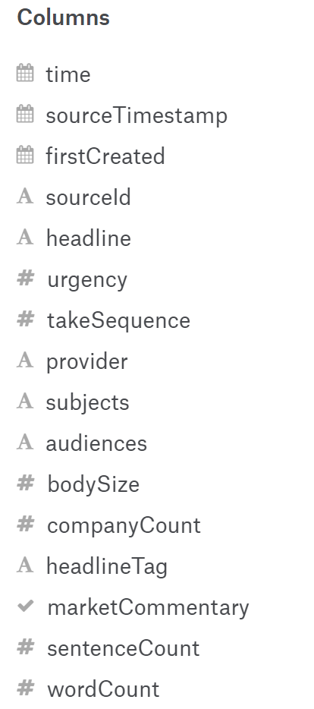
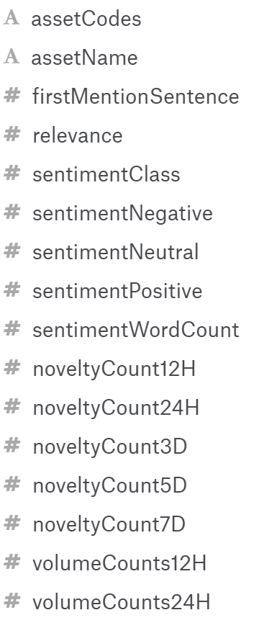
News Data
sentimentClass
- Negative
- Neutral
- Positive
NoveltyCount12H

Slide 8
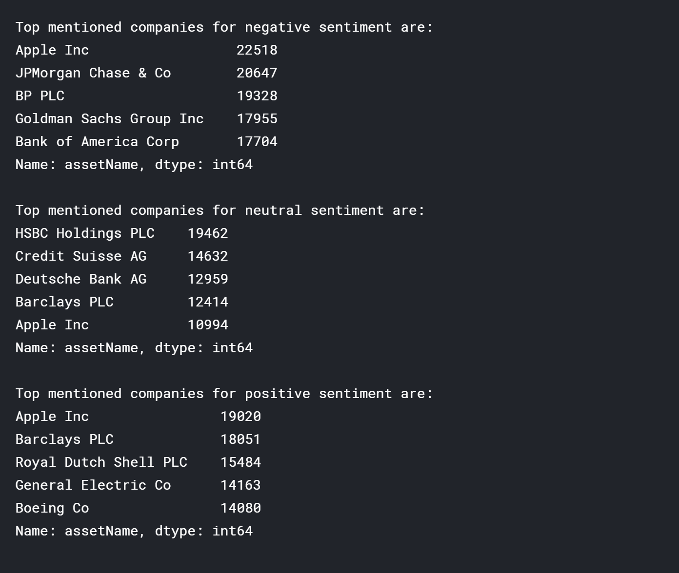
Example of News Data

Slide 9
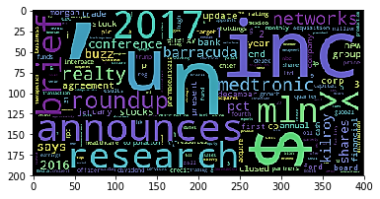
News Data – Headline Text Mining
Text Mining
- Word Cloud exclude stop words and symbol (”, “？”, “，”,…)

Slide 10
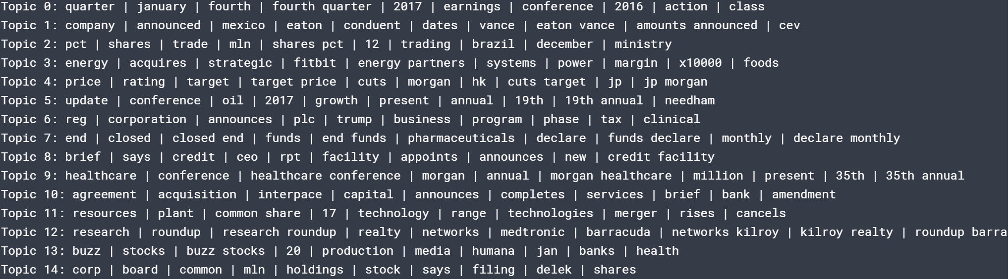
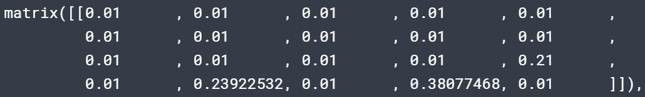
News Data – Headline Text Mining
IDA Modeling – 20 topics

Slide 11



Challenges and potential Issues
Time
Merging two datasets
Missing Value

Slide 12
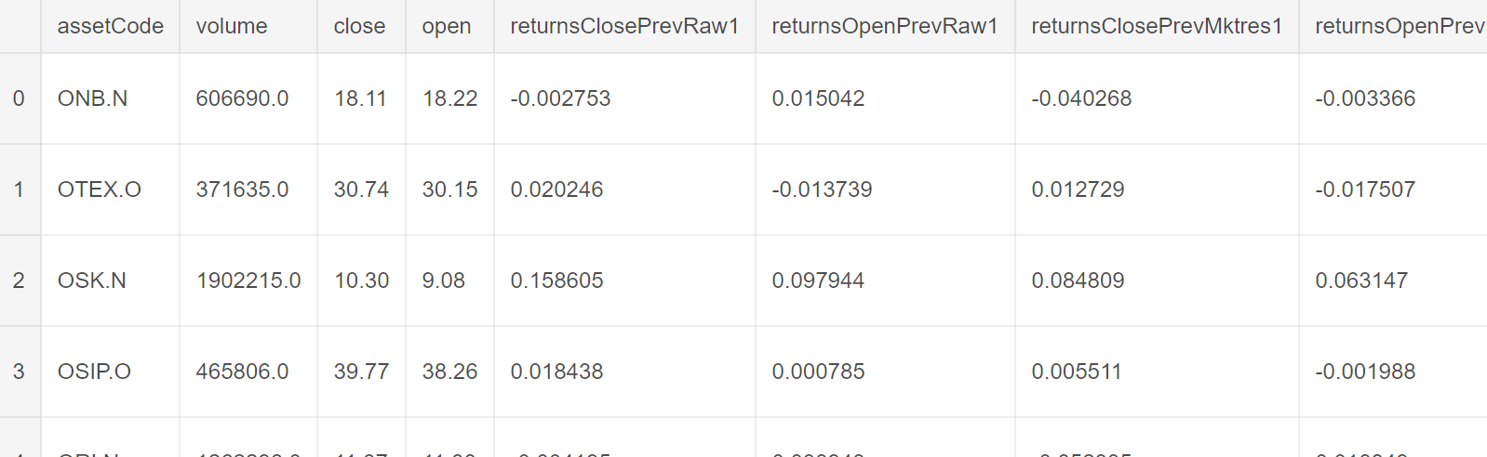
Merge two datasets
Use Asset code and Time and calculate the average value

Slide 13
Recall:
Maximum memory allowance: 17 GB
CPU Cores: 4
Total system usage allowance: 9 hours
Inexperienced machine learning beginner, lacking the experience in Kaggle competitions
Tasks:
Build a model that is:
Easy to implement for machine learning beginners
Easy to train fast without needing too much computing power
Able to produce a satisfying result

Slide 14
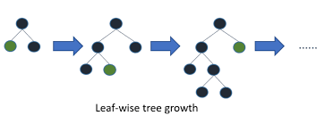
Our Solution
Use a gradient boosting framework that uses tree based learning algorithm: LightGBM
Reasons
Lower memory usage
Faster training speed and higher efficiency
Capable of handling large-scale data
Relatively easy to implement

Slide 15
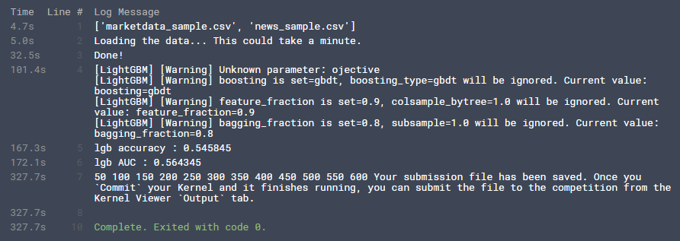
Settings & Result
train set = 5%, test set = 95%,
Public score: 0.63143, above over 50% of all competitors

Slide 16
Rumor
Some says a better result can be achieved using market data only
Some Ideas Raised
What if we only use the market data only and ignore the news data altogether?
What if we use a sequential model consists of a small amount of layers to make prediction on the stock movements based on market data only?

Slide 17

Another Try
Build a sequential model that consist of 3 layers
Activation functions: relu, relu, sigmoid
Loss function: binary crossentropy
Optimizer: Adam, beta1 = 0.9, beta2 = 0.999, epsilon = 10e-8
Result
Public score: 0.64881, beaten first try without the headache of topic modeling and joining the two data sets

Slide 18
Potential Causes
The price movement is more correlated to the market data than the new data
Did not account for lagging effect, the market may not fully response to a news about a certain asset immediately
Too many missing data in the news data for those assets that are not very well-known to the public
Did not perform a EDA to carefully select variables that will be used in the modeling
Inexperience in building model and handling data

Slide 19





Conclusion & Lesson Learnt
The models we produced are not very well built as they seem to put a heavier weight on variables in the market data than the ones in the news data
Having a validation set is useful for competitions that only allow practitioners to compile through Cloud
Kaggle kernel is a good starting point for beginners to look for ideas that can be used to make improvements
Learning curve is steep, This experience helped us to have a better understanding of machine learning
Machine/Deep Learning requires us to learning systematically, it’s something that you cannot master in a short period of time

Slide 20
Thank You!

Slide 21
Project Overview(System)
Maximum memory allowance: 17 GB
CPU Cores: 4
Total system usage allowance: 9 hours

Slide 22
Tasks
Use Market data and News data to predict stock price movements
Assign a confidence value within the interval [-1,1] to each asset to indicate if an asset is going to produce negative or positive return

Slide 23
Potential Causes
The price movement is more correlated to the market data than the new data
Did not account for lagging effect, the market may not fully response to a news about a certain asset immediately
Too many missing data in the news data for those assets that are not very well-known to the public
Did not perform a EDA to carefully select variables that will be used in the modeling
Inexperience in building model and handling data

Slide 24
Conclusion & Lesson Learnt
The models we produced are not very well built as they seem to put a heavier weight on variables in the market data than the ones in the news data
Having a validation set is useful for competitions that only allow practitioners to compile through Cloud
Kaggle kernel is a good starting point for beginners to look for ideas that can be used to make improvements
Learning curve is steep, This experience helped us to have a better understanding of machine learning
Machine/Deep Learning requires us to learning systematically, it’s something that you cannot master in a short period of time

